Slide 1
PyTorch Workshop
Ricky Ho
HCIBU

Slide 2
What is Supervised Machine Learning?
Primarily used for Predictions
Detect anomaly workload patterns
Predict performance issues
Predict propensity to purchase based on customer deployment and usage
Training Phase
Prepare data from past (input, label)
Split data into training, validation, and testing
Capture the relationship between input & label into a model
Fine tune model on validation data
Validate performance of model against testing data
Inferencing Phase
Use the trained model for predicting future data (input, label)
Retrain model after deprecation

Slide 3
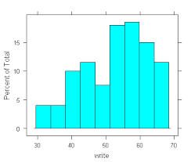
Machine Learning Process
Feature Engineering
Model Building
Raw data
Select & Sample
Split
Handle missing & Outlier
Training Data
Test Data
Transform & Create feature
K-fold cross Validation
Evaluate
Featured Data
Train Data
Validation Data
Model Performance
Hyper parameter
Training
Machine Learning Algorithm
Predictive Model
Notes:
Feature Engineering: Construct various input features to use for prediction
Model Building: Various ML algos to fit data
Decision Tree / Random Forest / XGBoost
Naïve Bayes / Bayesian Network / HMM
Linear / Logistic Regression / SVM

Slide 4
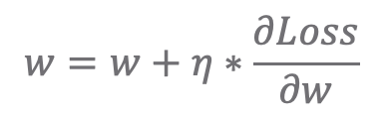
Differentiation Programming Paradigm
Training
labels
Parametric
Model
Training
raw input
Loss Function
prediction
Parameters
Loss
Update parameters
Compute Gradient
$$w=w+η∗\frac{∂Loss}{∂w}$$
Notes:
Model uniquely defined by parameters
Tune parameters to minimize the loss
Compute gradient of Loss
Update parameters with gradient descent

Slide 5
vMLP Usage Instructions
http://decc-draco-sm-master001:31505/
Click on notebooks tab in left column; Click + new server button
Specify your email id without domain name as the server name
Select custom image and paste in
mlaas-docker-local.artifactory.eng.vmware.com/vmlp-tensorflow-1.13.1-notebook-cpu:0.5.1.41a
Click the spawn button
After notebook server has finished spawning click the connect button to open Jupyter Lab
After connecting to Jupyter Lab, Click + button in upper left corner and select terminal
Type in following command:
After clone is finished, open pytorch_training folder

Slide 6
Tensor Operation: Notebook code walkthrough
Tensor
Multi-Dimension Arrays
Dimension shape
Element access
Conditional access
Index access
Slicing
Binary operation
Broadcast
Creation
Random, Zero, One, Diagonal
Gradient descent
Backward
Aggregation
Sum / Cumsum / Max
Along different dimensions
Combining Tensors
Concat / Stack
Dot product
matmul
Transformation
Squeeze / Unsqueeze / View
Transpose
Selection using another Tensor index
Gather

Slide 7
Lab 1: Implement Linear Regression

Slide 8
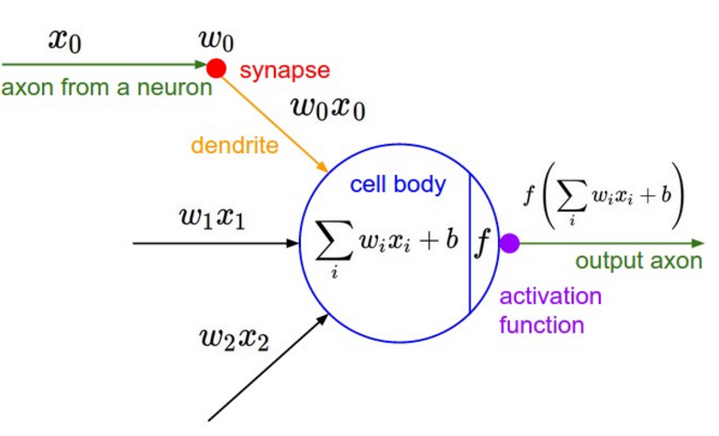
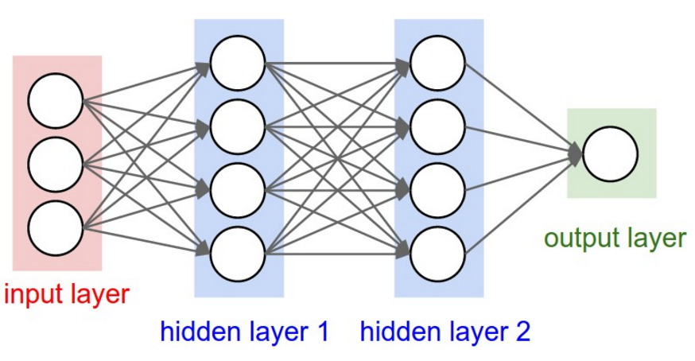
Universal Function as Neural Network
Notes:
Bottleneck of Traditional Machine Learning:
Feature Engineering: requires human experts with lots of domain knowledge
Deep Neural Network:
Hidden Layers automatically construct features from input
Layer in NN:
Number of neuron units
Each neuron
Weighted sum: linearly combine last layers outputs
Activation function: introduce nonlinearity
Fully Connected: Every neuron is connected between consecutive layers

Slide 9
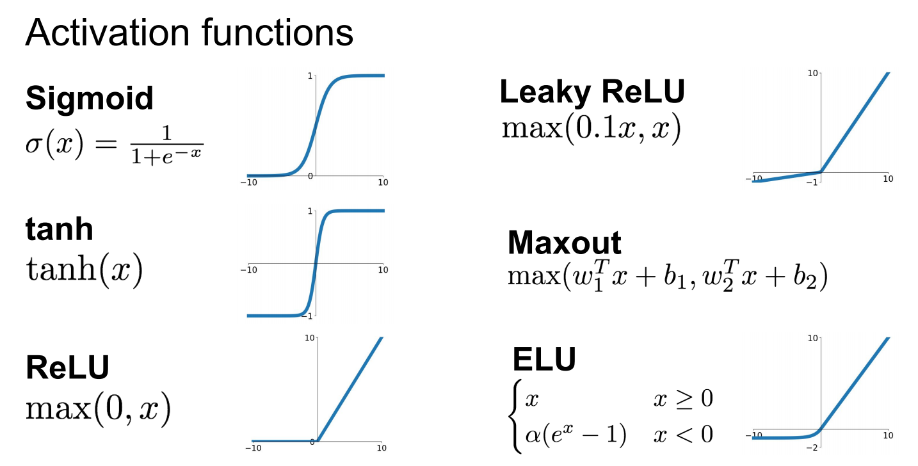
Choosing Activation Function
Notes:
ReLU: most popular used in practice for hidden layers
Sigmoid / tanh used in earlier generations of Deep Learning
Used in output layers rather than hidden layers
Other three are more sophisticated, less frequently used

Slide 10
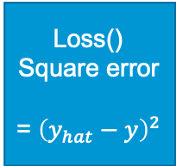
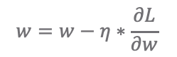
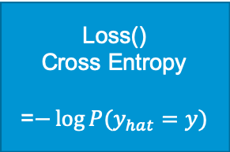
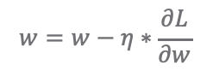
Choosing Loss Function
Regression: (predict a numeric quantity)
Classification: (predict a discrete class)
y
y
Predict(x;w)
Predict(x;w)
P(y_hat = a)
Loss()
Square error
= ${\left(y_{hat}−y\right)}^{2}$
Loss()
Cross Entropy
=$−\log{P(y_{hat}=y)}$
y_hat
P(y_hat = b)
x
x
P(y_hat = c)
$$w=w−η∗\frac{∂L}{∂w}$$
$$w=w−η∗\frac{∂L}{∂w}$$
Notes:
Regression: minimize the difference between prediction and true value
Mean Squared Error
Classification: maximize the likelihood of training label P(y | x)
Cross Entropy Loss: Log likelihood of the true label

Slide 11
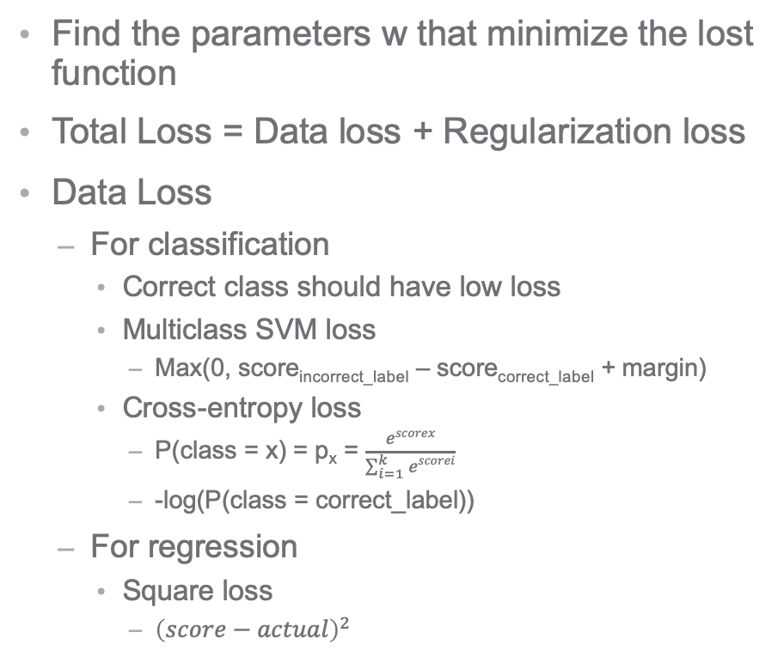
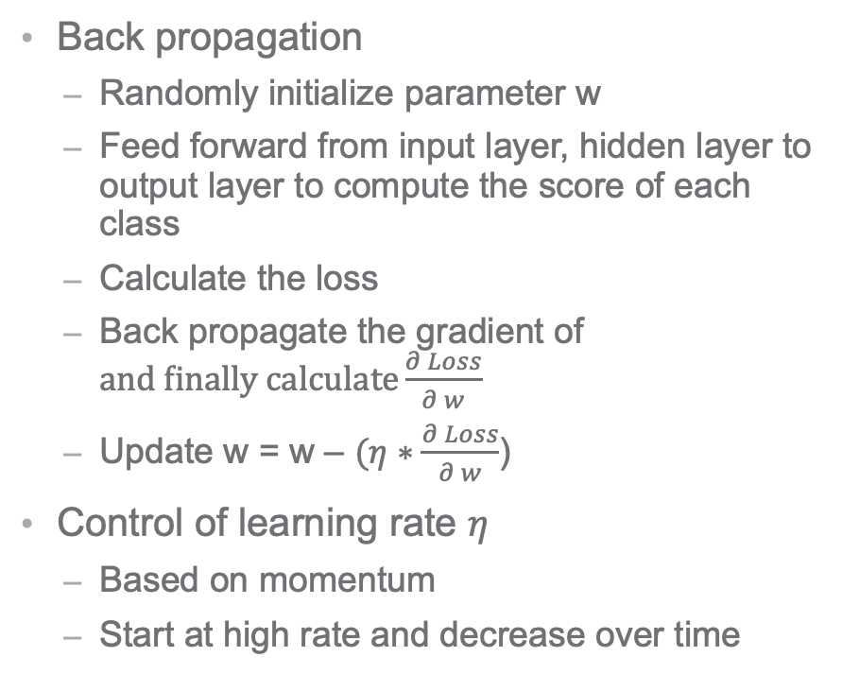
NN Model Training
Find the parameters w that minimize the lost function
Total Loss = Data loss + Regularization loss
Data Loss
For classification
Correct class should have low loss
Multiclass SVM loss
Max(0, score_{incorrect_label} – score_{correct_label} + margin)
Cross-entropy loss
P(class = x) = p_{x} = $\frac{escorex}{\sum_{i=1}^{k}{escorei}}$
-log(P(class = correct_label))
For regression
Square loss
${\left(score−actual\right)}^{2}$
Back propagation
Randomly initialize parameter w
Feed forward from input layer, hidden layer to output layer to compute the score of each class
Calculate the loss
Back propagate the gradient of $and finally calculate\frac{∂ Loss}{∂ w}$
Update w = w – $(η∗\frac{∂ Loss}{∂ w}$)
Control of learning rate $η$
Based on momentum
Start at high rate and decrease over time
Notes:
Learning Rate: affects influence of each training loop
Low Learning Rate: model takes very long to converge to optimal params
High Learning Rate: gradient of Loss will keep fluctuation and will be more difficult to converge

Slide 12
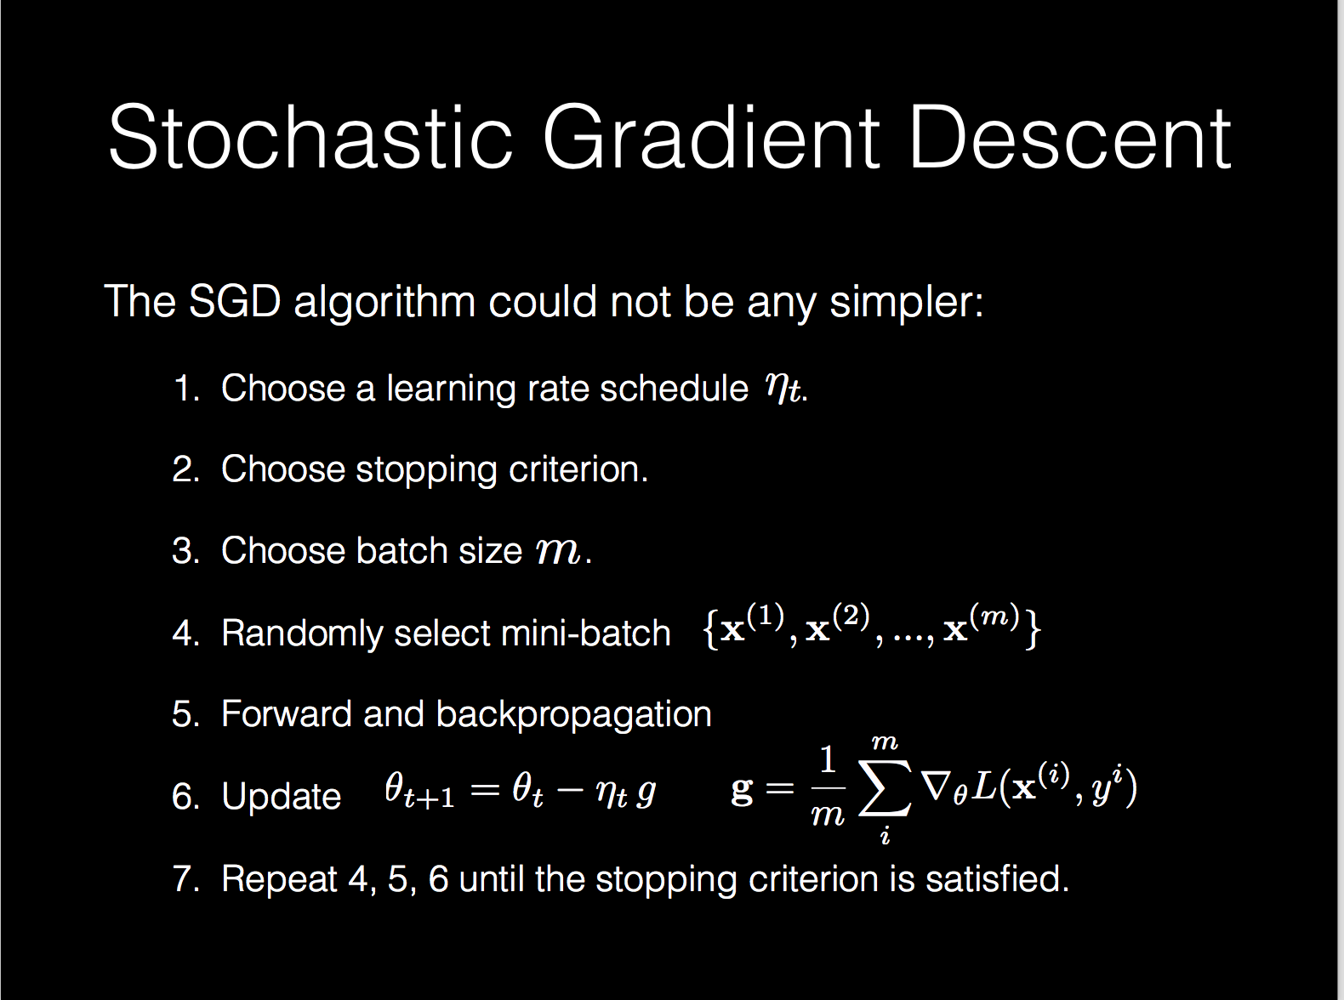
Notes:
When do we start to update our parameters?
2 Extremes
Full dataset: takes into account all data; model will take long to update parameters (especially small learning rate)
Every datapoint: fast; model parameters hard to converge due to fluctuation
Minibatches: break down dataset into multiple batches
Extremes are special case of minibatch
1 Epoch is going through all minibatches within full dataset
Can train on minibatches in parallel by matching batch to GPU

Slide 13
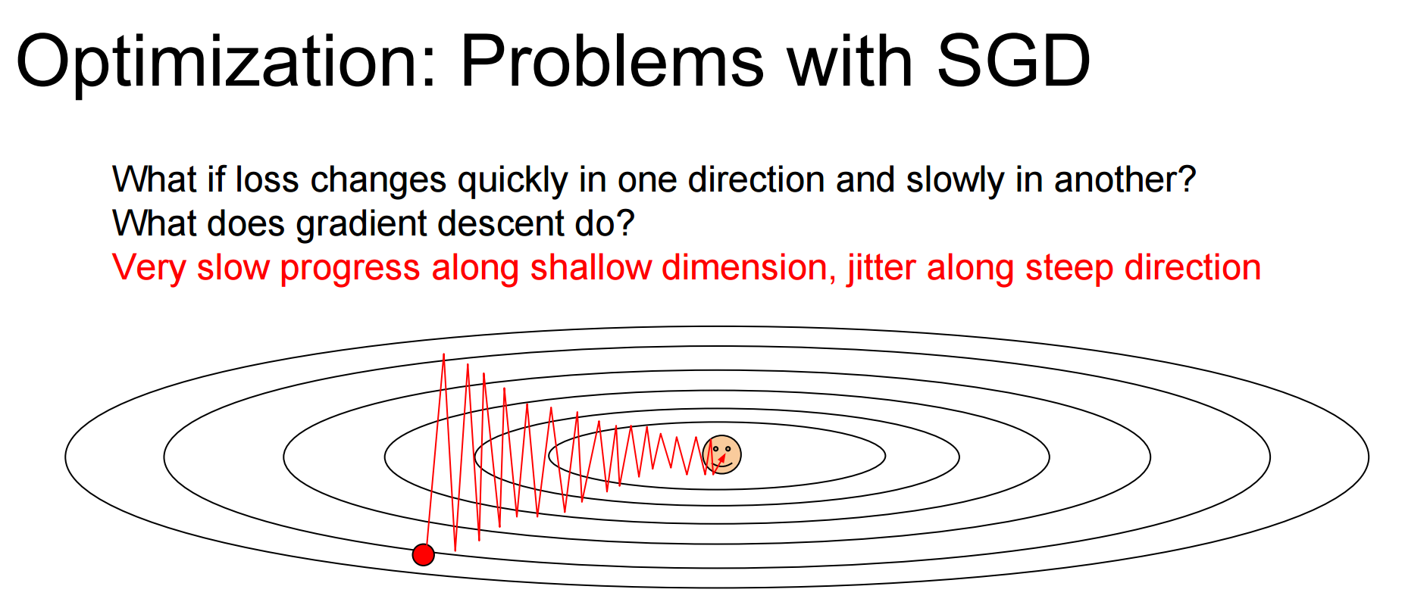
Notes:
Problem: Ovular shape of contour
model spends a lot of time jittering back and forth before converging to minimum.
Leverage horizontal momentum to steer direction to minimum

Slide 14
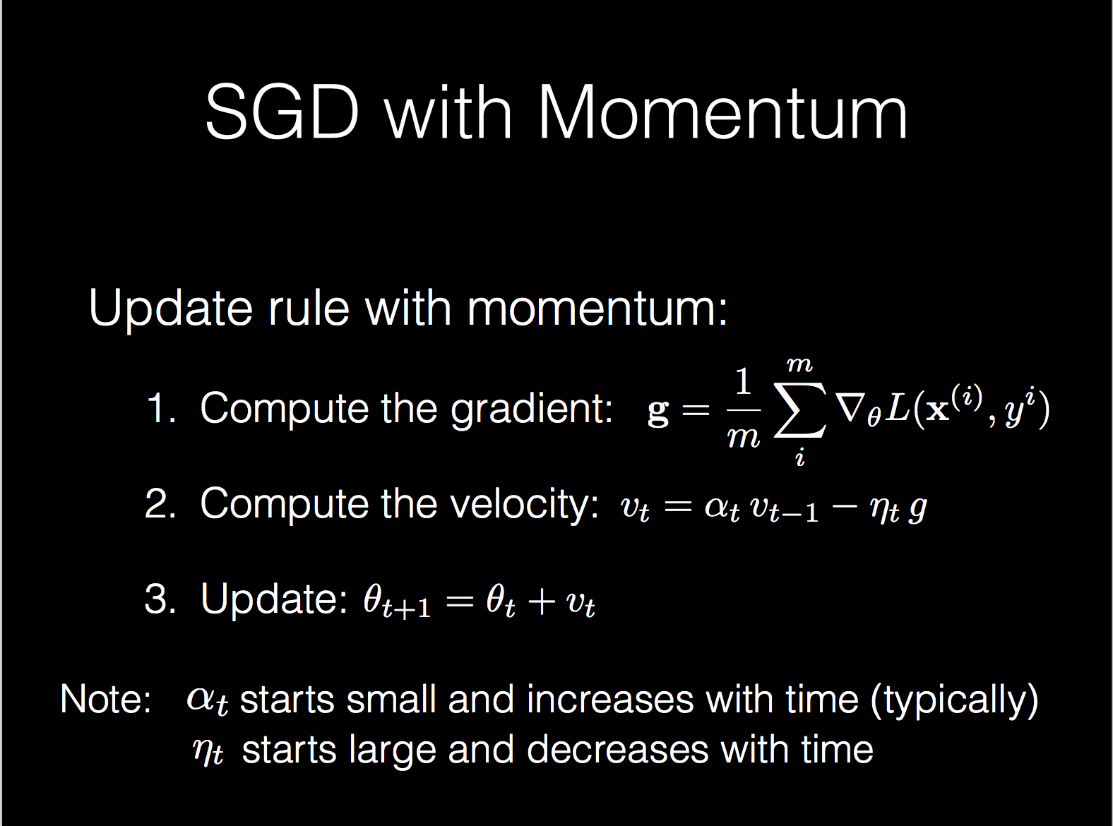
Notes:
Additional techniques to update the parameters
RMSProp
Adagrad
Adadelta
Adam (popular approach)

Slide 15
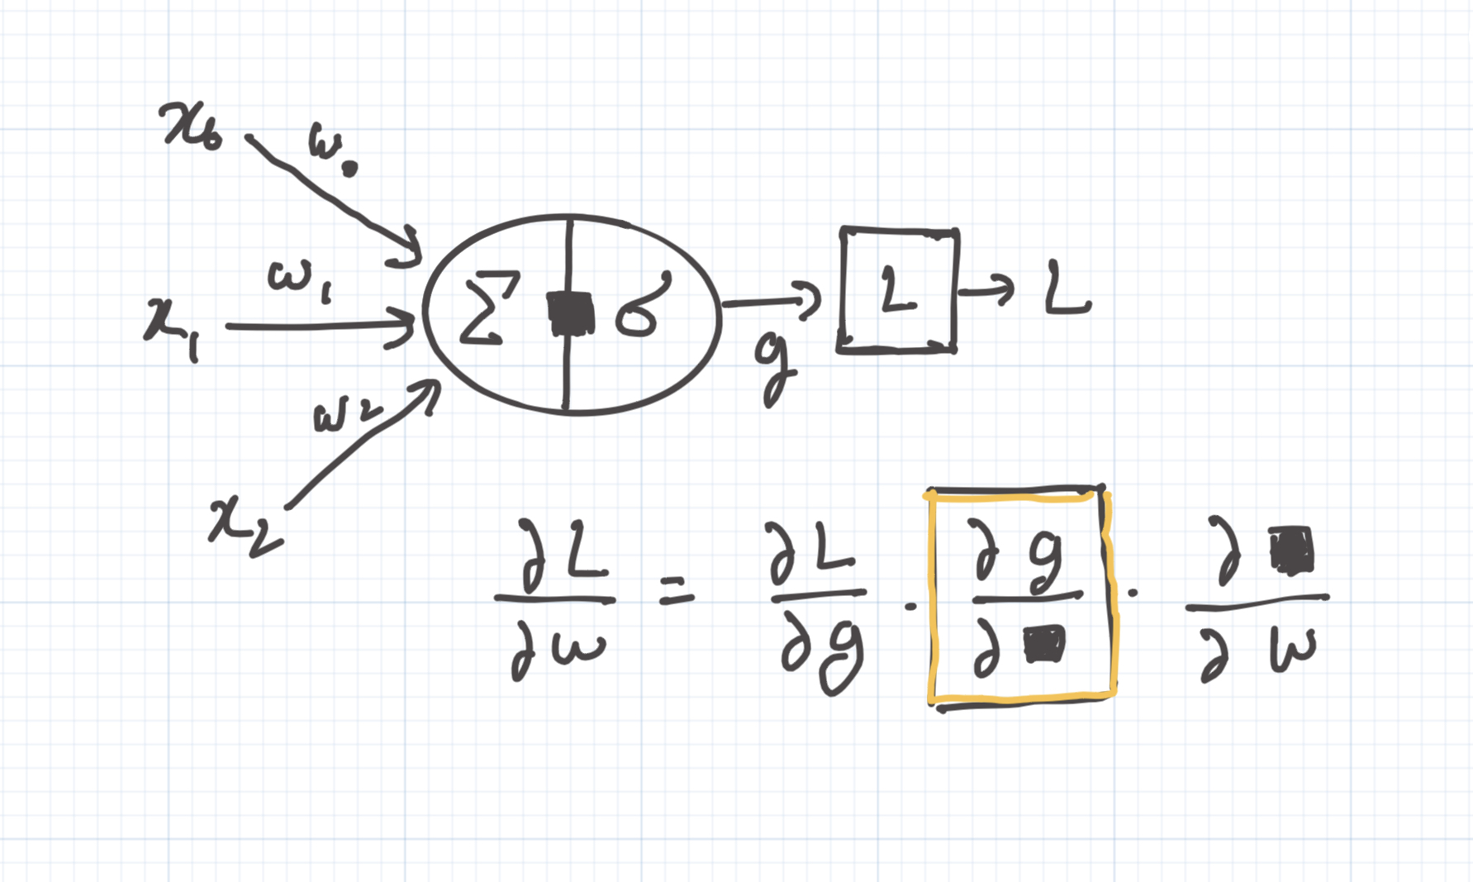
Vanishing Gradient Problem
Notes:
Solution: Shift input to activation function to mean 0 and sd 1

Slide 16
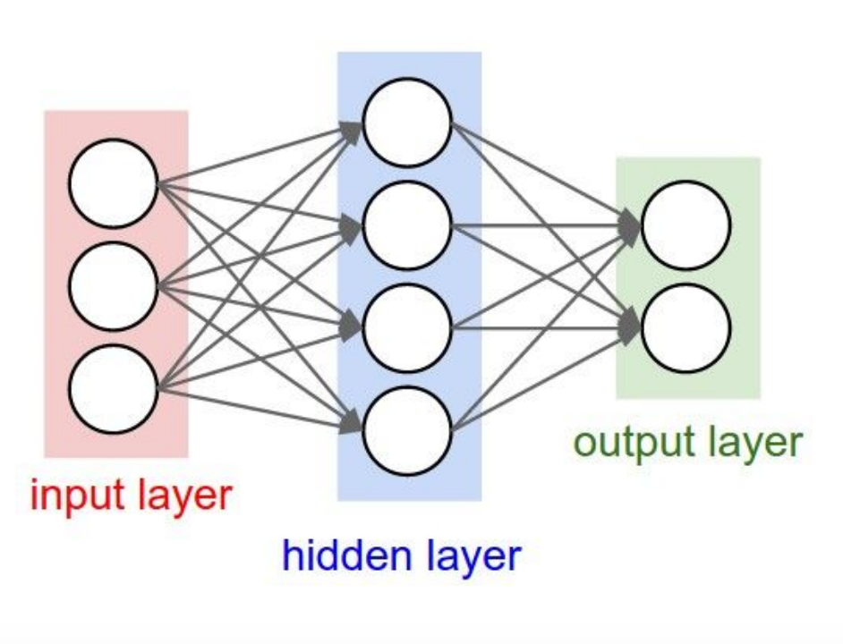
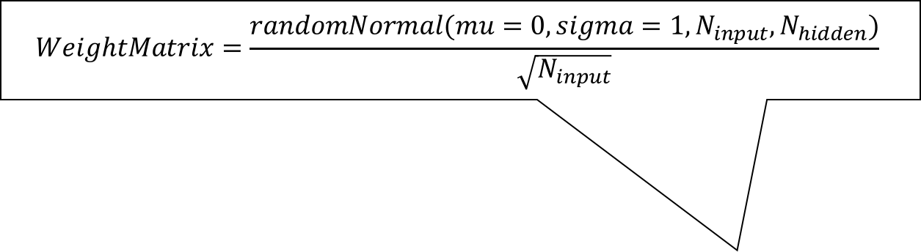
Weight initialization
$$WeightMatrix=\frac{randomNormal(mu=0, sigma=1, N_{input},N_{hidden})}{\sqrt{N_{input}}}$$
Notes:
- Keep weights center at 0 with sd 1

Slide 17
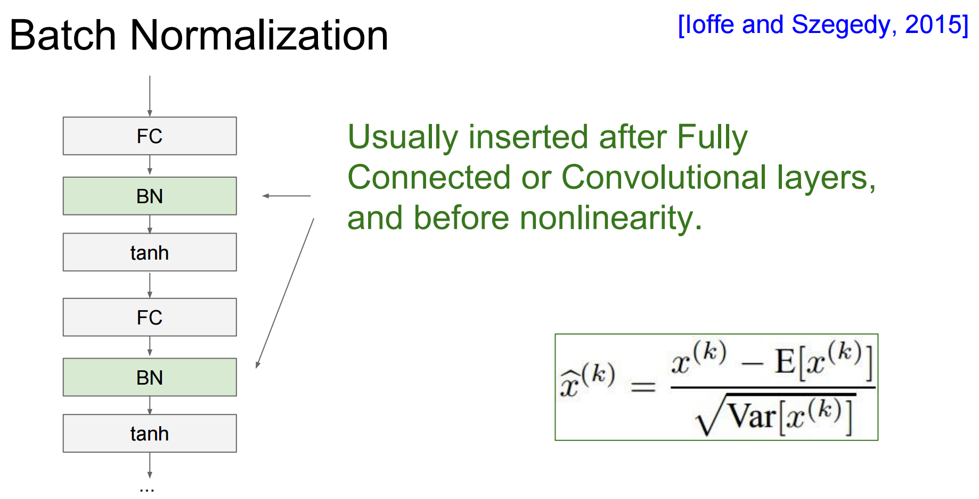
Notes:
Keep input data center at 0 and sd 1
Why do batch normalization at every layer?
Every progressive layer situation will no longer be the same
Every batch has its own mean and sd
During prediction
- Take average of mean and sd of training data for the last few batches

Slide 18
Problem of Overfitting
Learn the relationship too specific to your past data
Pick up signal (good)
Pick up noise (bad)
Not generalizable to future data
Accuracy for future data will drop
Traditional ML Solutions
Weight Regularization
Ensemble Methods
Restrict power of model
Use more data
Notes:
Weight Regularization: Penalize large weights; reduce paying too much attention for particular features
Ensemble Methods: Averaging out the result of multiple models to cancel out random noise

Slide 19
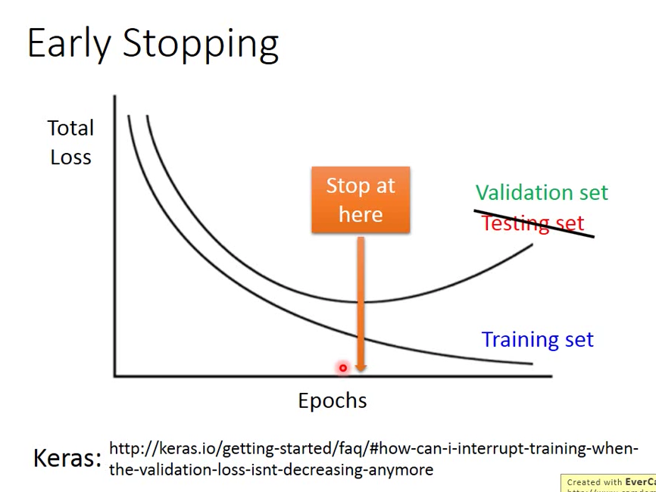
Notes:
Detects when overfitting starts to occur
Stop training when this happens

Slide 20
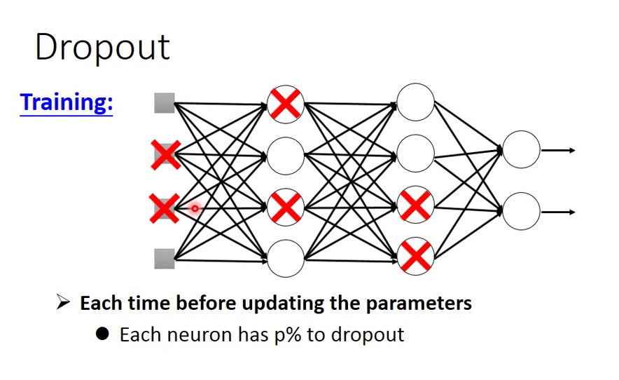
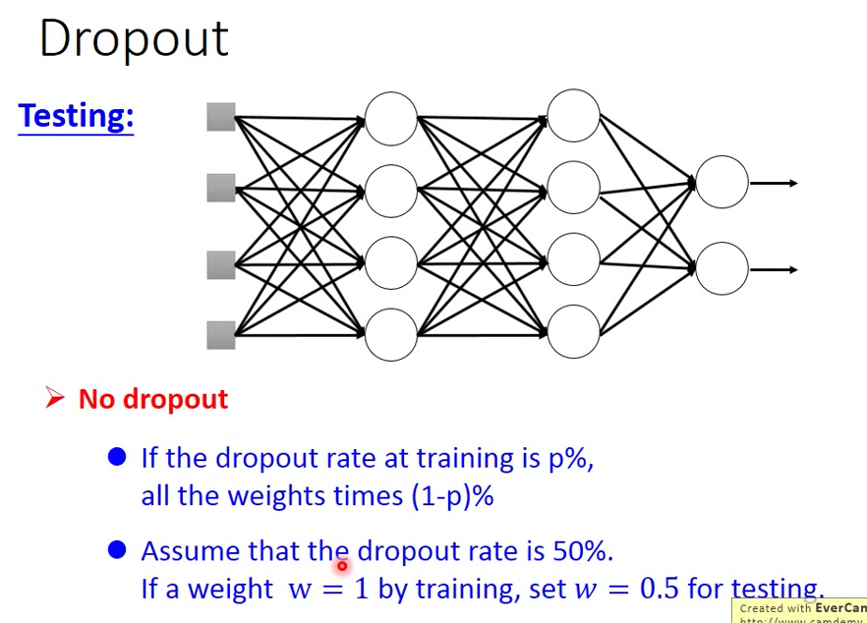
Notes:
Only do during training stage
Resample at every batch
At every layer, randomly drop percentage (p) of neurons
Scale up weighted sum after dropout
Inferencing stage
Without dropout is equivalent to ensembling many dropout models

Slide 21
Pytorch prediction code structure: Notebook code walkthrough
Data preparation
Split data into train / validate / test
Network construction
Init (FC, BatchNorm, Dropout)
Forward
Training
Loss function (HingeLoss, MSE, CrossEntropy)
Optimizer (SGD, Adam, Learning rate)
Backward
Validation loss vs Training loss
Saving and Loading models

Slide 22
Lab 2: FizzBuzz

Slide 23
Lunch Break

Slide 24
Image Classification using Convolutional Neural Network
Notes:
Input: Image in 3d RGB Values ; Output: Predicted Class
Problems with FC Layers for Image Classification:
Lose neighboring spatial relationship
Performs poorly when image is shifted and transformed

Slide 25
CNN common setup
INPUT -> [[CONV -> RELU]*N -> POOL?]*M -> [FC -> RELU]*K -> FC
Notes:
Solution Convolutional Neural Networks
Conv Layers
Pooling Layers
Previous in FC: Data has 2 Dimensions (Batch, Feature)
Now in CNN Image Data: Data has 4 Dimensions (Batch, Channels, Height, Width)

Slide 26
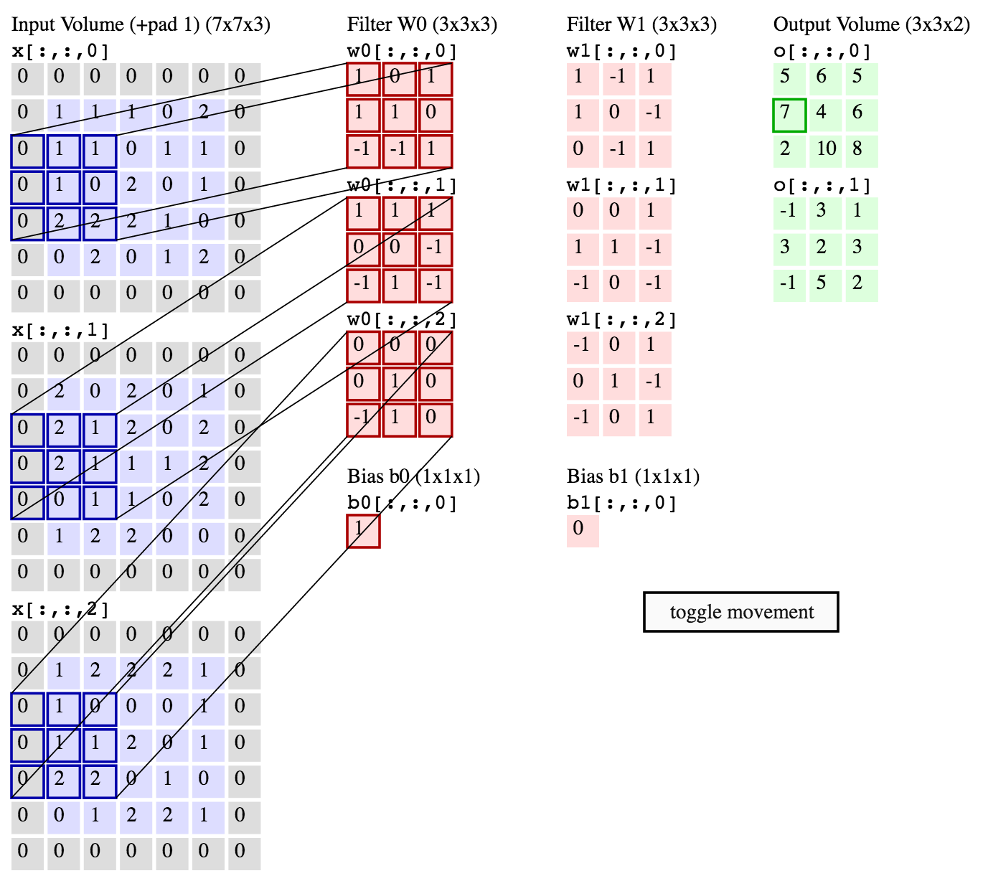
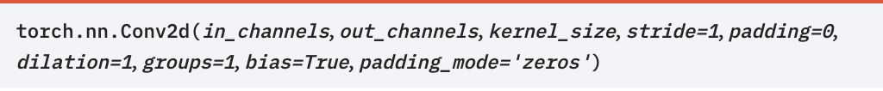
CONV Layer
Filter must have same depth of input layer
Size is typically 3x3 or 5x5
Slide the filter across the grid to compute dot product
Strike size (e.g. 1)
Pad zero at edge to retain size
No of filters determines depth of next layer
Notes:
Filter has 3 dimensions: (channels, height, width) where width=height
Multidimensional weights in conv layers
FC can be considered as special case of CNN
Filter slidable panel of weights

Slide 27
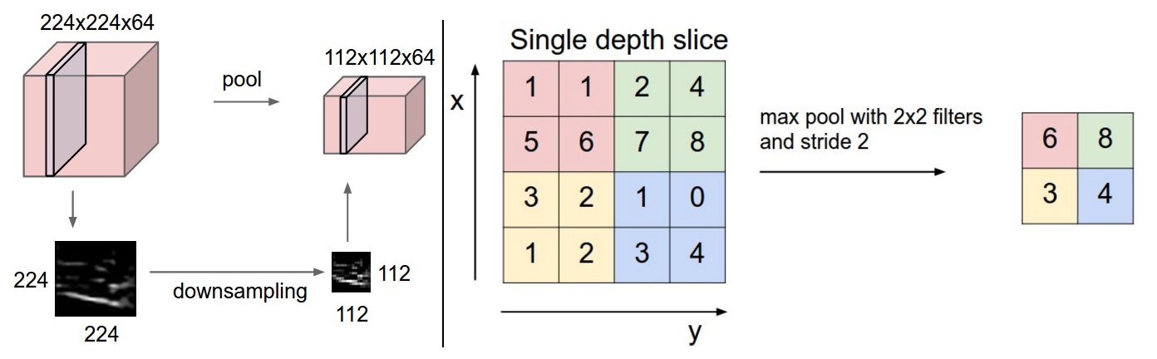
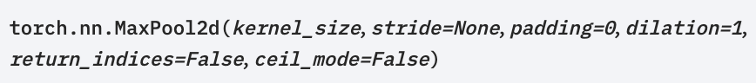
POOL Layer
A method of regularization (blurring the details) to prevent overfit
Reduce the number of parameters
Notes:
Sliding and movement operation Is similar to a conv filter
However, conv filter has no weights
Instead of dot product, we use avg or max across the filter
Properties
Uninvertable
Kernel size is often the same as the stride
Thus non–overlapping filters

Slide 28
Pytorch CNN: Notebook code walkthrough
Image data structure
Tensor representation
Transformation for image data
Display image
Data loader
CNN
1D and 2D
Parameters (filter size, strides, padding)
Input shape
Output shape
Pooling
Max pool, Avg pool

Slide 29
Lab 3: CFar10

Slide 30
Sequence prediction
Input is a sequence of elements that has inter-dependencies
Speech signals
Words in a sentence
Video frames
User’s sequence of actions
Stock price
Time series workload / machine data
Use cases
Predicting next word from previous words
Machine language translation
Video captioning
Stock price prediction

Slide 31
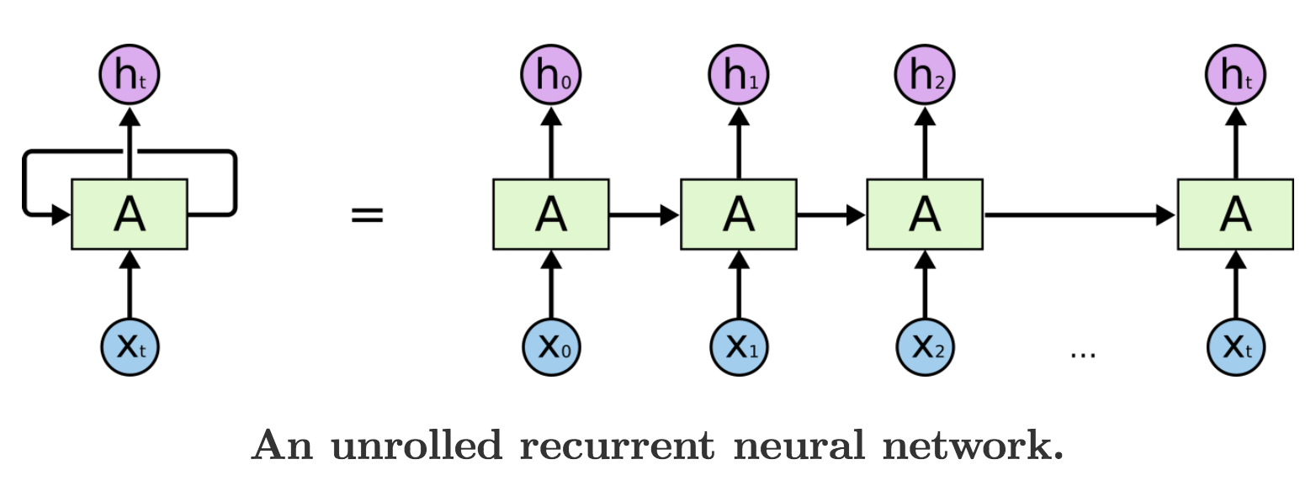
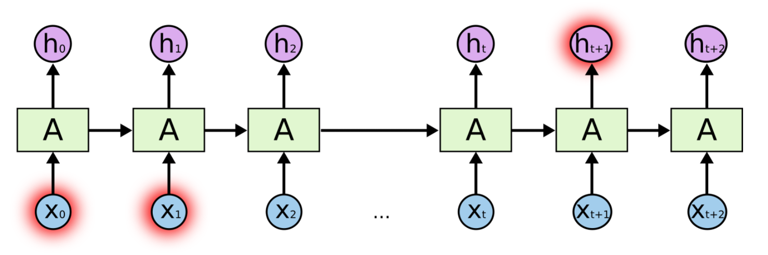
Recurrent Neural Network (RNN)
For data that has sequential dependencies (e.g. TimeSeries data)
Each observation is not independent
Previous state affects subsequent state
Problem with long term memory
Notes:
2 inputs to RNN Layers
Input data
Output of previous timestep called ”hidden state”
“hidden state” accumulates meaning of all previous timesteps
Strengths of RNN
Can handle variable size inputs unlike FC and CNN
Example:
Input x: stock price at every day;
output h: one day shift of x; price tomorrow of each day
Problem with Long Term Memory
Nature of RNNs: many many layers
Vanishing gradient problem
Series of multiplication through layers causing small and large values
RNNs can not be performed parallely
Current timestep depends on output of previous timestep

Slide 32
Recurrent Neural Network
Output:
(Record, Timestep, Units)
Or (Record, Units)
Weight: (Units + Features, Units)
Same weight parameters
Same weight parameters
State[t]
Capture all previously seen input with decay
Encoder Output
h_{k} = 𝛔(W.([x_{k}, h_{k-1}]))
Initial state
noOfUnits
W
W
…
W
h₀
h₁
h_{k-1}
h_{k}
noOfUnits
x₁
x₂
noOfFeatures
x_{k}
noOfTimeSteps
noOfSamples
Input
Input: (Record, Timestep, Features)
Input
Notes:
Input Dimensions: (Batch, Timesteps, Feature)
Output, Last Hidden:
Output Dimensions: (Batch, Timesteps, Hidden Units)
Last Hidden: (Batch, 1, Hidden Units)

Slide 33
Many to one
One batch of Output
dimension = (noOfSamples, noOfUnit2s)
y_{k}
noOfUnit2s
Encoder
V
FC(noOfUnit2s)
Initial state
noOfUnits
W
W
…
W
h₀
h₁
h_{k-1}
h_{k}
noOfUnits
x₁
x₂
noOfFeatures
x_{k}
noOfTimeSteps
Input
One batch of Input
dimension = (noOfSamples, noOfTimeSteps, noOfFeatures)
Input

Slide 34
Many to many (aligned)
One batch of Output
dimension = (noOfSamples, noOfTimeSteps, noOfUnit2s)
y₁
noOfUnit2s
y_{k-1}
y_{k}
noOfUnit2s
V
V
V
Initial state
W
W
…
W
h₀
h₁
h_{k-1}
h_{k}
noOfUnits
x₁
x₂
noOfFeatures
x_{k}
noOfTimeSteps
Input
One batch of Input
dimension = (noOfSamples, noOfTimeSteps, noOfFeatures)
Input

Slide 35
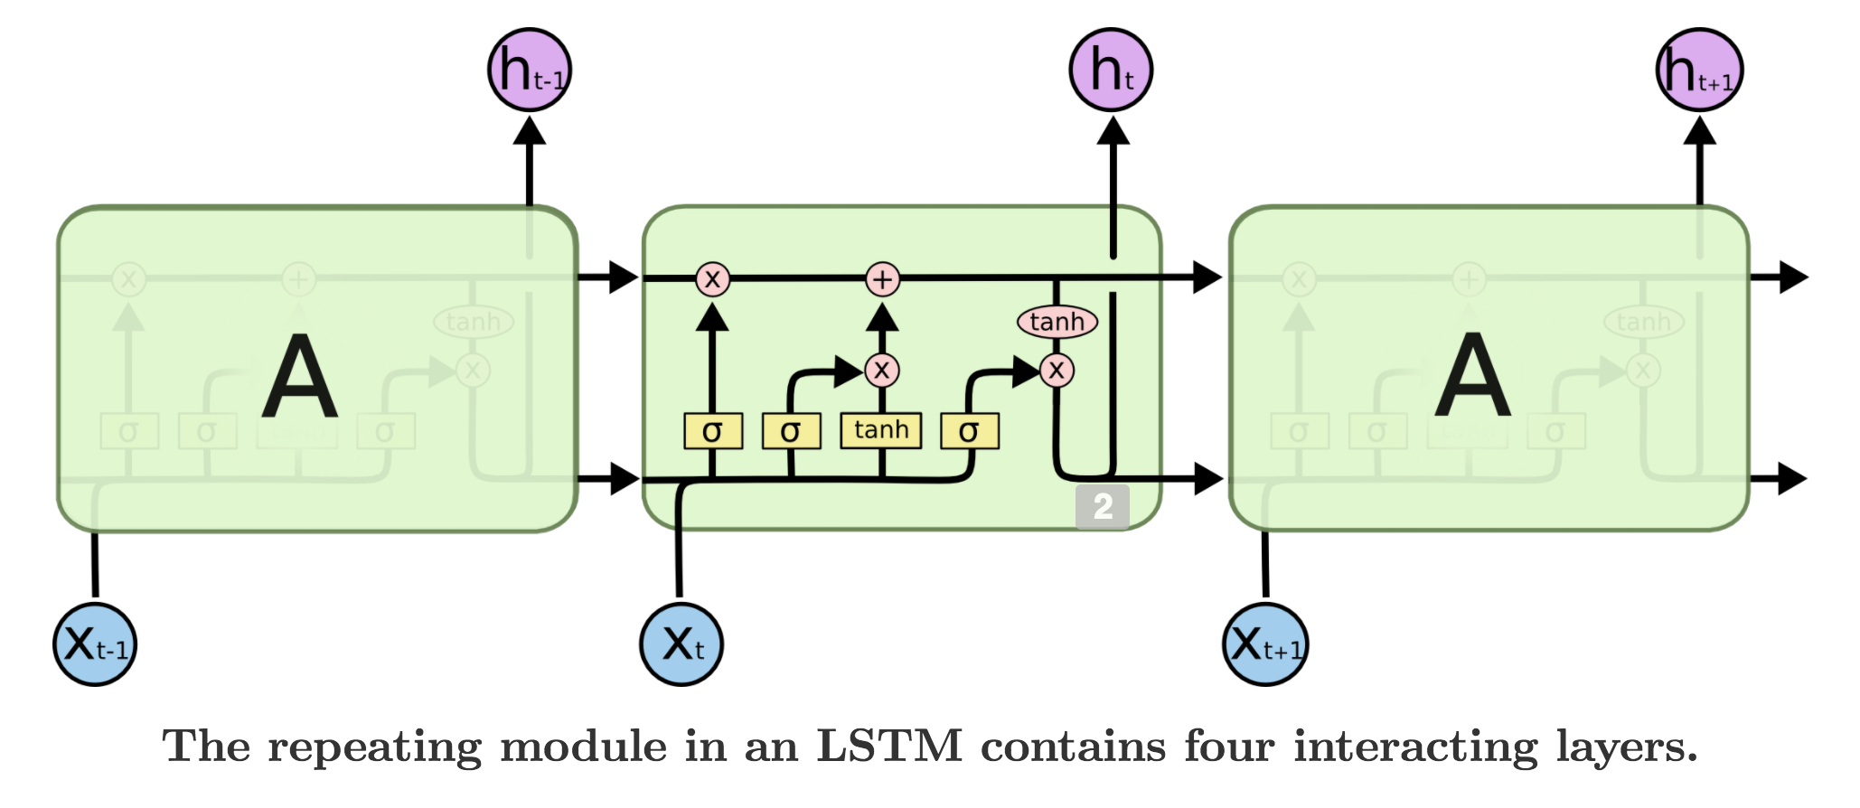
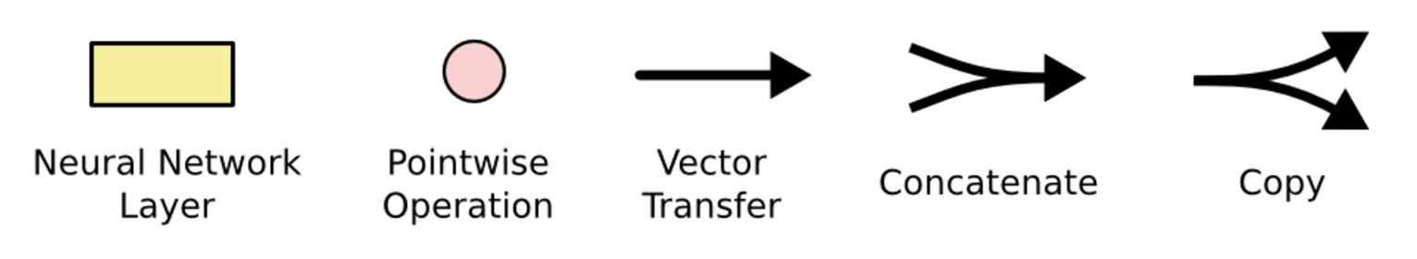
Long Short Term Memory (LSTM)
Long Term
Memory
multi-dimensional
multi-dimensional
Short Term
State
noOfFeatures
Notes:
Aimed to solve vanishing gradient problem of RNN
Previous: only 1 hidden state
Now: 1 long term hidden state (c), 1 short term hidden state (h)
Long term memory: addition only
Short term memory: multiplication and addition

Slide 36
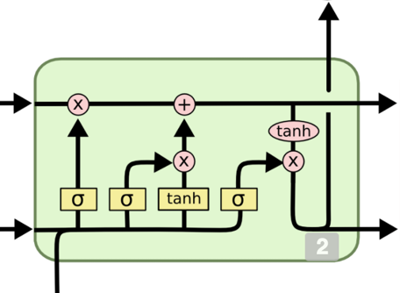
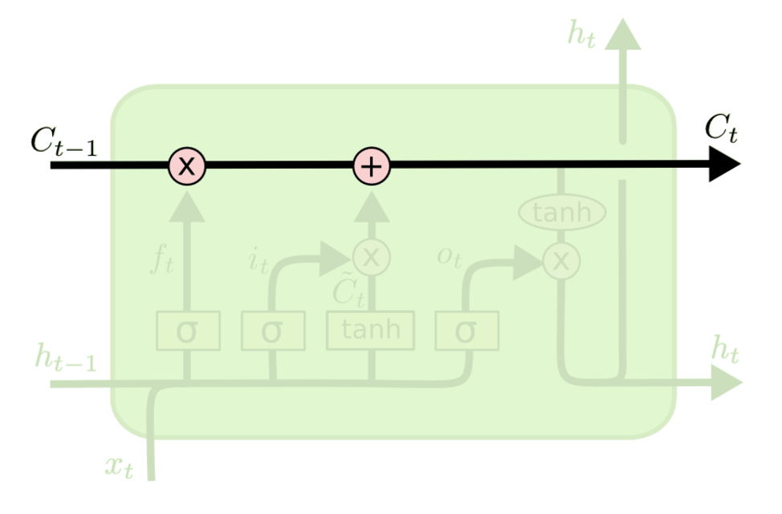
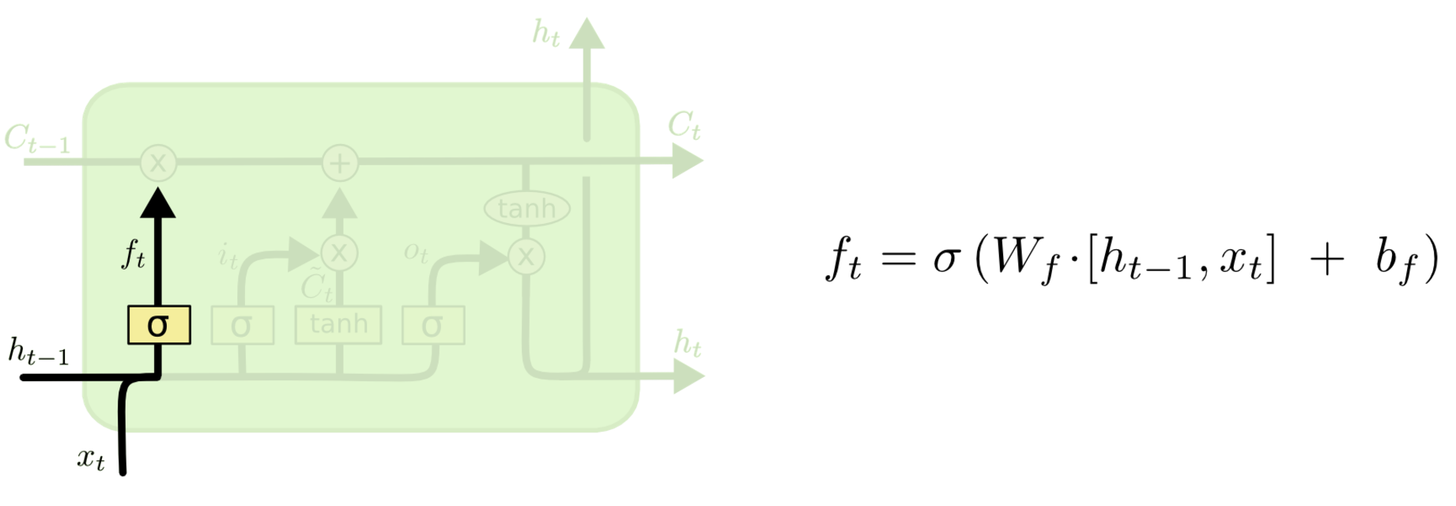
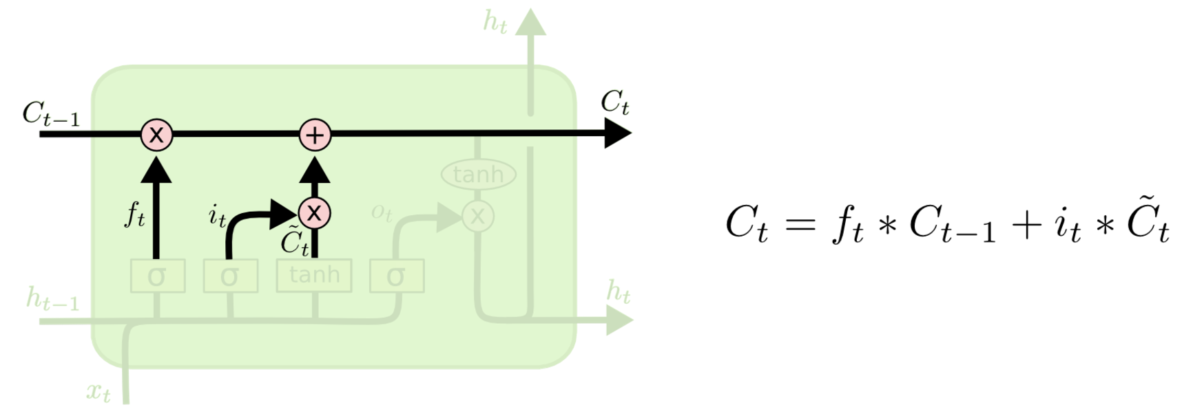
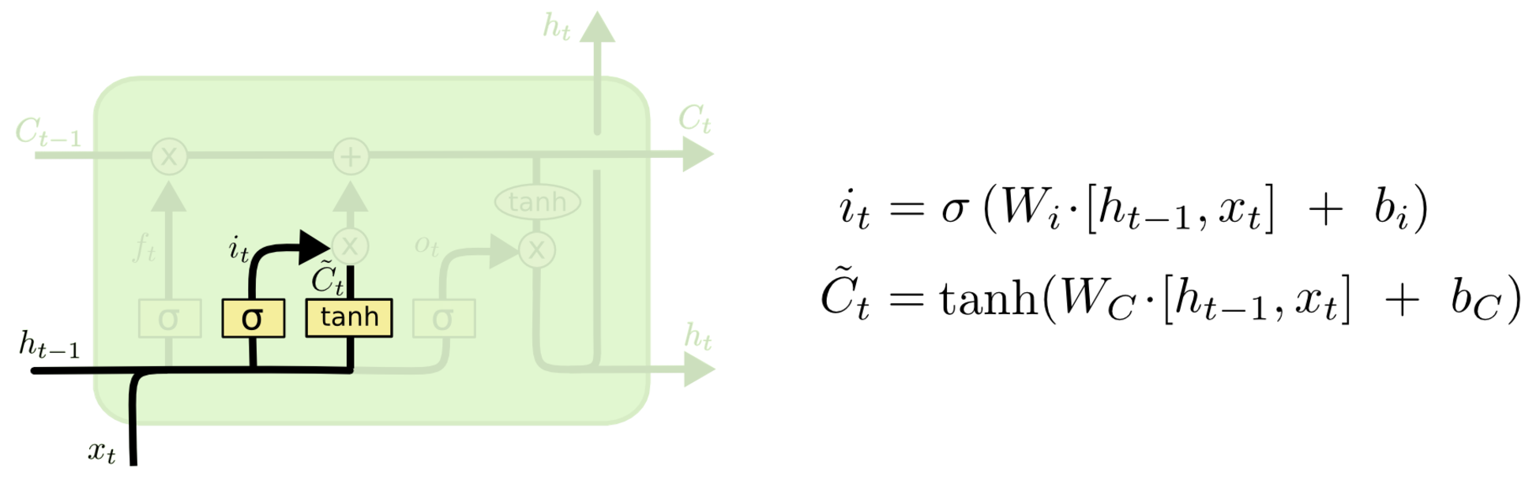
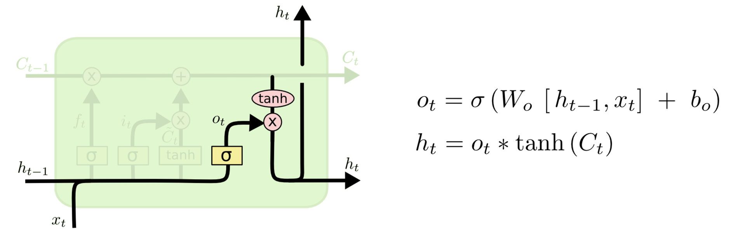
Forget Gate
Control how much long-term memory will survive
Output Gate
Control how much long-term memory will be passed on to next short-term state
Input Gate
Control how much short-term state & input will be combined with long-term memory

Slide 37
LSTM (Long Short Term Memory)
Not Output
noOfUnits
Initial memory
W
W
…
W
c₀
c₁
c_{k-1}
c_{k}
noOfUnits
…
h₀
h₁
h_{k-1}
h_{k}
noOfUnits
Initial state
noOfUnits
x₁
x₂
noOfFeatures
x_{k}
Encoder Output

Slide 38
Stacked (Multi-Layer) RNN / LSTM
Encoder Output
noOfUnits
W’
W’
…
W’
h’₀
h’₁
h’_{k-1}
h’_{k}
noOfUnits
Initial state
Initial state
noOfUnits
W
W
…
W
h₀
h₁
h_{k-1}
h_{k}
noOfUnits
x₁
x₂
noOfFeatures
x_{k}

Slide 39
Pytorch RNN: Notebook code walkthrough
TimeSeries data structure
RNN
Batch / Time / Feature dimensions
Parameters (units, hidden, number of layers)
Input shape
Output shape (output and hidden)
LSTM
Batch / Time / Feature dimensions
Parameters (units, hidden, number of layers)
Input shape
Output shape (output and hidden)

Slide 40
Lab 4: Sine Function TimeSeries Prediction

Slide 41
More Network Architectures

Slide 42
Bi-directional RNN
y₁
y_{k}
U
U
y_{f1}
y_{fk-1}
y_{fk}
Forward direction
V_{f}
V_{f}
V_{f}
h₀
W_{f}
h₁
W_{f}
…
h_{k-1}
W_{f}
h_{k}
x₁
x₂
x_{k}
h’₁
W_{b}
h’₂
W_{b}
h’_{k}
W_{b}
h’_{k+1}
Backward direction
V_{b}
V_{b}
V_{b}
y_{b1}
y_{b2}
y_{bk}

Slide 43
Seq2Seq (Many to many, unaligned)
Output sequence
y₁
Decoder
y_{n-1}
y_{n}
V
V
V
W’
h’₁
W’
…
h’_{n-1}
W’
h’_{n}
<start>
Encoder
h₀
W
h₁
W
…
h_{k-1}
W
h_{k}
x₁
x₂
x_{k}
encoded value
Can be considered as the embedding of input sequence
Input sequence

Slide 44
Seq2Seq (with attention)
y₁
Decoder
y_{n-1}
y_{n}
W’
W’
W’
Attention
Weight
h’₀
W
h’₁
W
…
h’_{n-1}
W
h’_{n}
Softmax
Dot
(similarity)
Dot
(Weighted sum)
Attention
Multiple encoded value from different x
e₁
e₂
Encoder
x₁
x₂
x_{k}

Slide 45
References and Credit
http://cs231n.stanford.edu/syllabus.html
https://www.youtube.com/watch?v=fegAeph9UaA&list=PLJV_el3uVTsPy9oCRY30oBPNLCo89yu49
http://colah.github.io/posts/2015-08-Understanding-LSTMs/
https://www.youtube.com/watch?v=xki61j7z-30

